Slide 1

Exam Management System
Project I
Course Code: CAPJ256
Semester: 4th sem.
Prepared by:
Karuna Magar(35502104)
Avipsha Adhikari(35502102)

Slide 2
Table of Contents
Introduction
Problem Statement
Objectives
Scope and Limitation
Methodology
Gantt Chart

Slide 3
Agenda
System Modules
System Design
Context Diagram
Implementation Tools
Testing Evidence
Conclusion
References

Slide 4
Introduction
The Exam Management System is a computerized application designed to manage and organize all examination-related activities such as scheduling exams, assigning rooms, maintaining records, and publishing results in an efficient way.
The system provides different functionalities for students, teachers, and administrators i.e. students can view schedules and results, teachers can upload questions and enter marks, and admins manage records and user authentication
It reduces manual work, minimizes errors, improves accuracy, and makes the examination process more systematic, secure, and efficient within an educational institution.

Slide 5
Problem Statement
Managing exam schedules, room assignments, and records manually takes a lot of time and effort.
Manual data handling can lead to errors in marks and result preparation.
Students face difficulty in getting timely exam information.
Managing large amounts of examination data manually becomes complex and unorganized.

Slide 6
Objectives
To develop a computerized system for managing examination activities efficiently.
To provide students with easy access to exam schedules, room numbers, and results.
To enable teachers to upload questions and manage students’ marks systematically.
To reduce manual work and improve accuracy in exam data management.

Slide 7
Scope and Limitation
Scope
Students can view exam schedule, room number, and results
Teachers can upload questions and add students’ marks.
Admin can manage student and teacher records.
Admin can approve authenticated login for users.
The system helps organize and manage exam data efficiently.
Limitations
The system works only offline.
Access is limited to authorized users.
Data is stored locally, so backup is required.
The system supports only basic exam management functions.
Technical maintenance may be required.

Slide 8
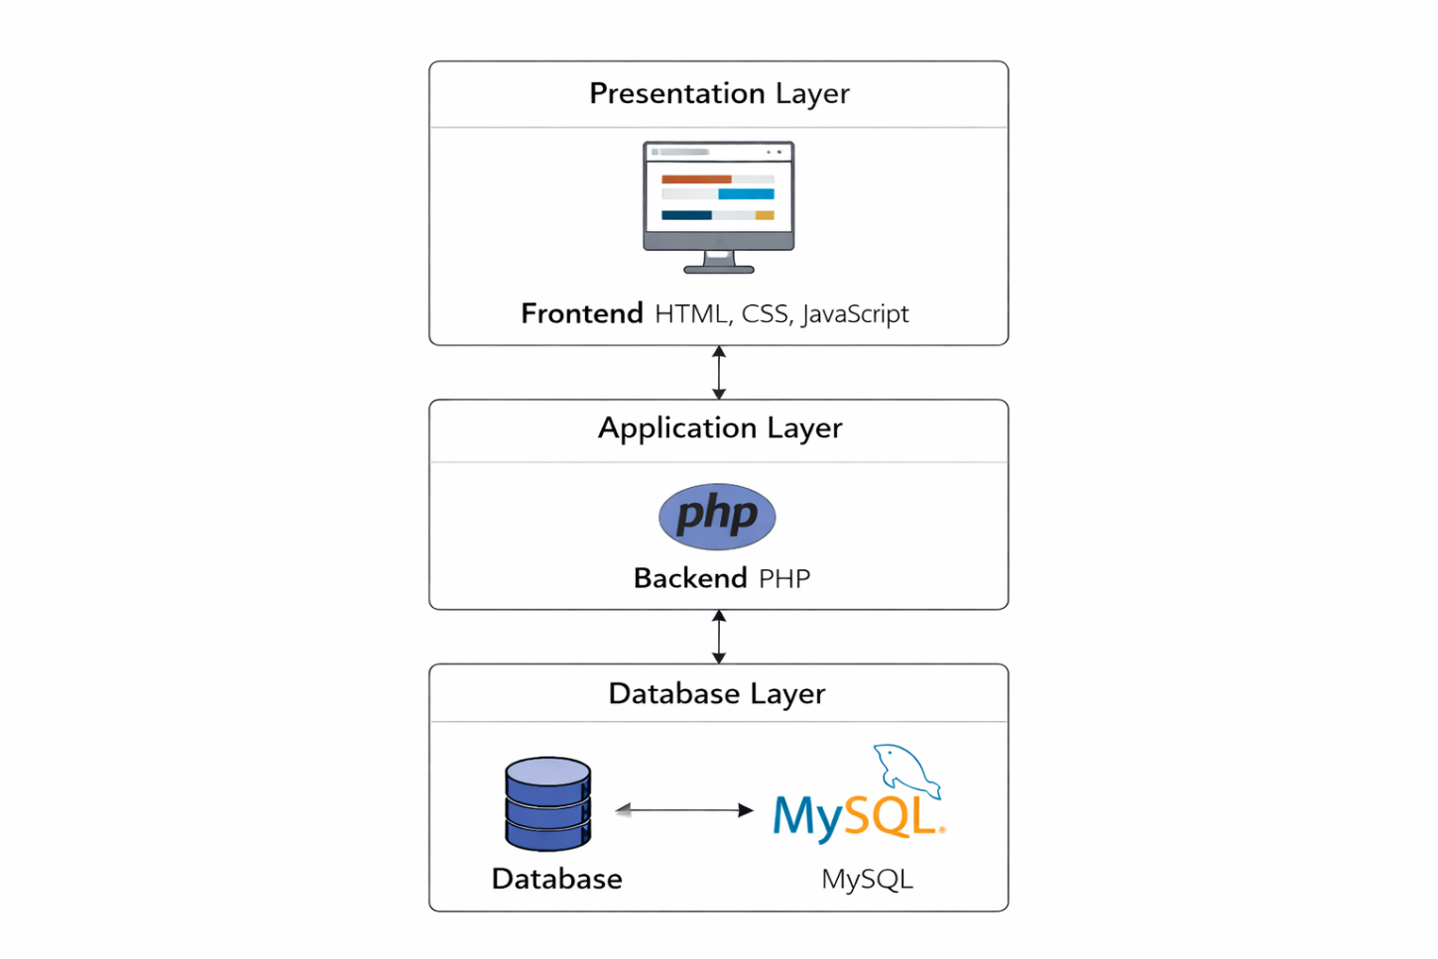
System Architecture

Slide 9
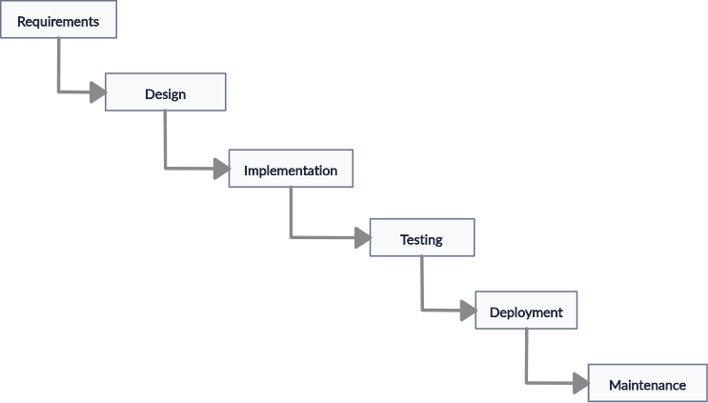
Methodology
Figure: Waterfall Model of Exam Management System

Slide 10
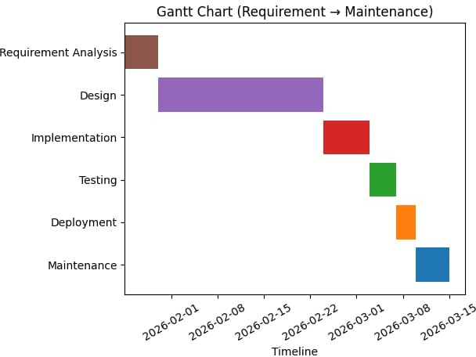
Gantt Chart
Figure: Gantt Chart of Exam Management System

Slide 11
Requirement Analysis
Functional Requirement
Users can create accounts with secure and unique login credentials.
Registered users can log in to access the system.
Admin can manage exam related data such as schedules,student record and result.
Teacher can upload questions and enter or update marks
Students can view exam schedules ,room numbers and results.

Slide 12
Non-Functional Requirement
The system should respond quickly and efficiently to user actions.
The interface should be simple, user-friendly, and easy to navigate.
Data should be secure and protected from unauthorized access.
The system should work in an offline environment.
It should be easy to maintain and update in the future.

Slide 13
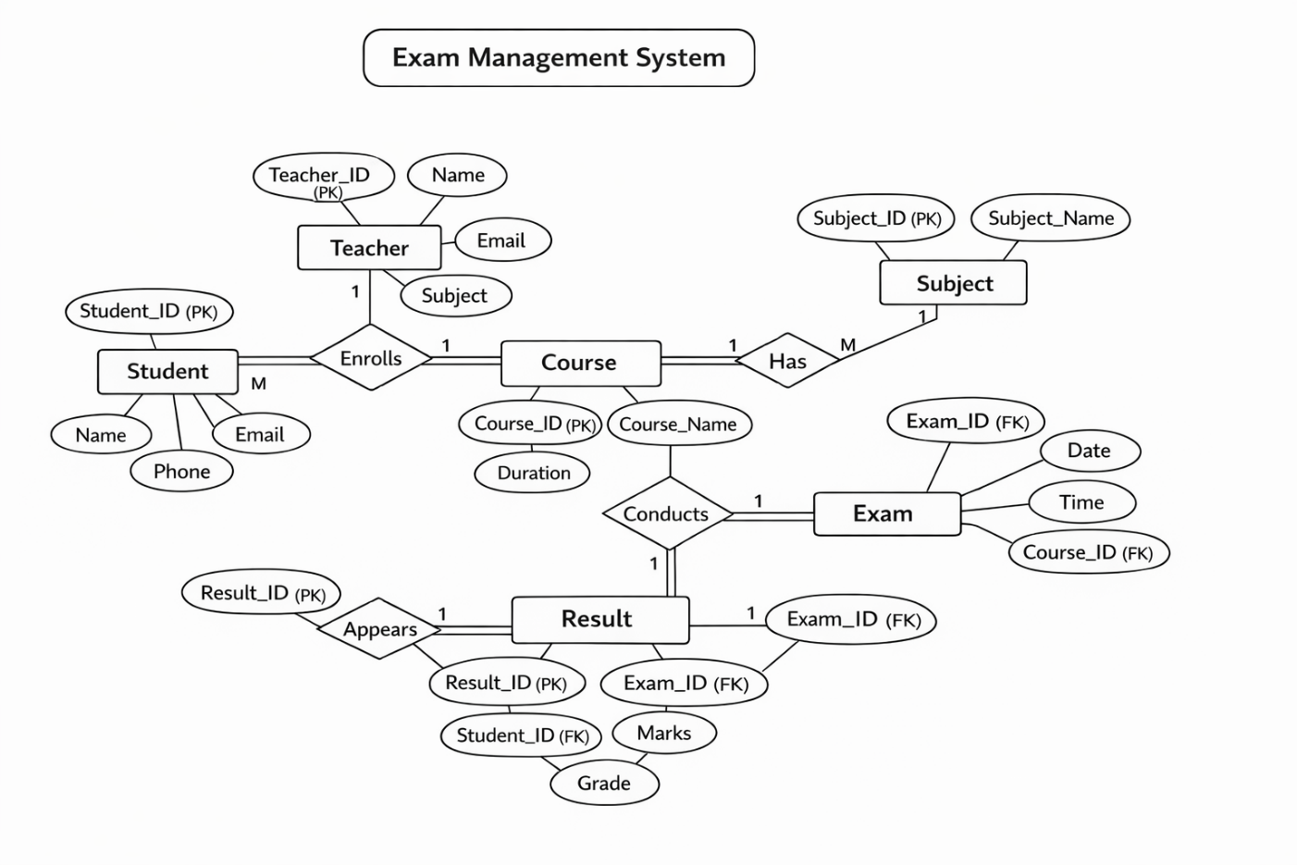
ER Diagram
Figure: ER Diagram of Exam Managment system

Slide 14
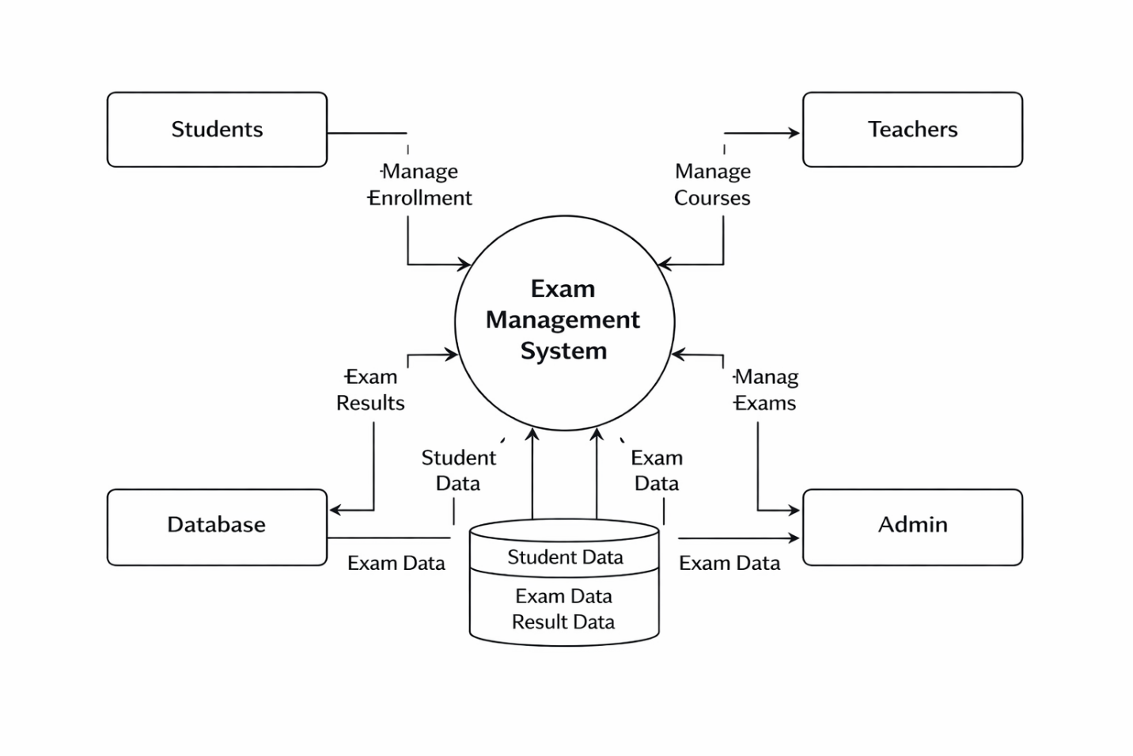
Context Diagram

Slide 15
Implementation Tools
Frontend
HTML, CSS, JavaScript
Backend
PHP for server-side scripting
MySQL for database management
Development Tools
GitHub for version control
Visual Studio Code for coding

Slide 16
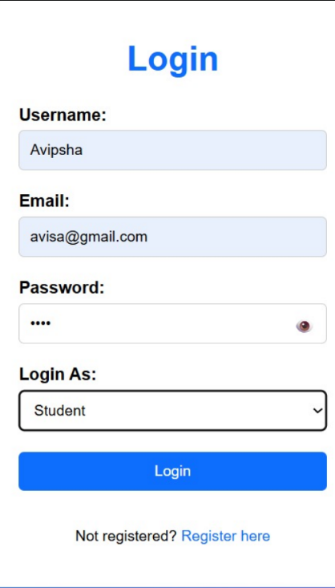
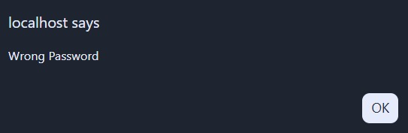
Testing Evidences
(User Login with invalid credentials)

Slide 17
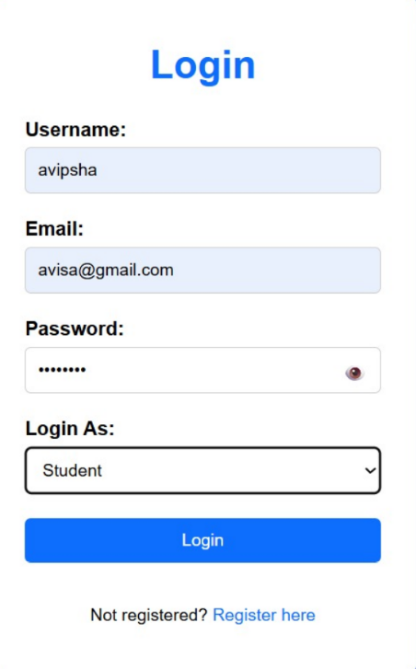
(Account create with valid credentials)

Slide 18

(Homepage)

Slide 19
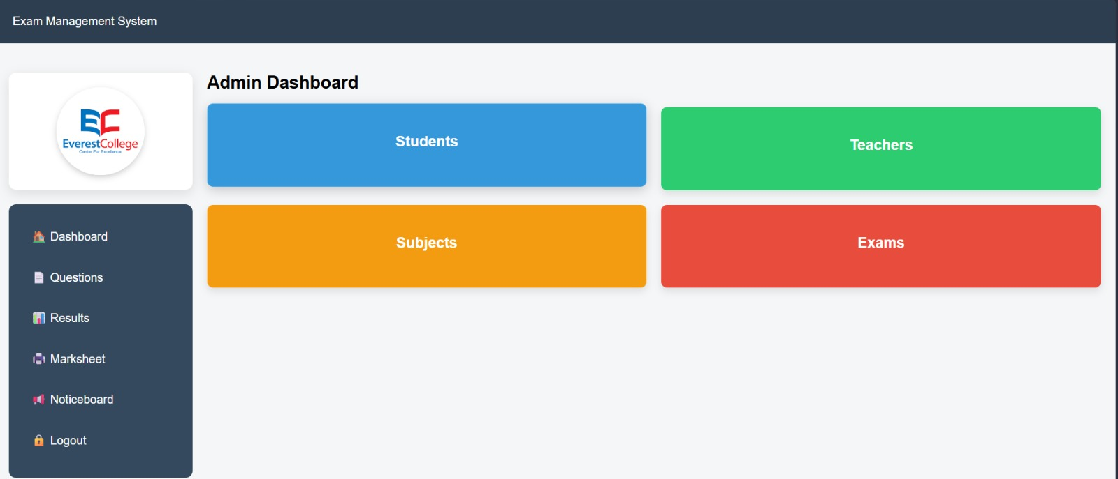
Admin
Dashboard

Slide 20
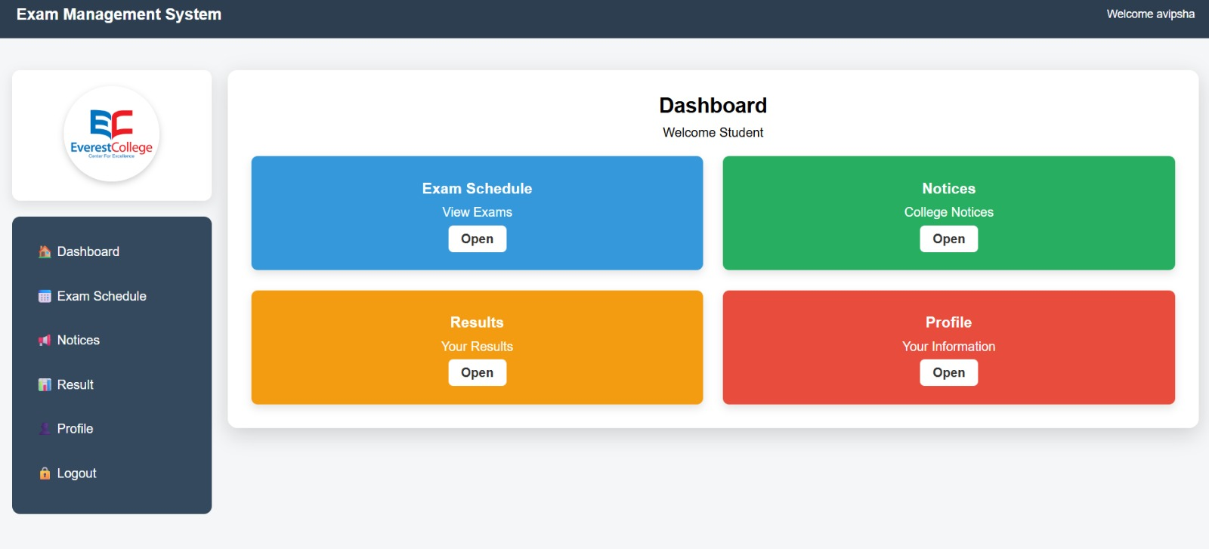
Student

Slide 21
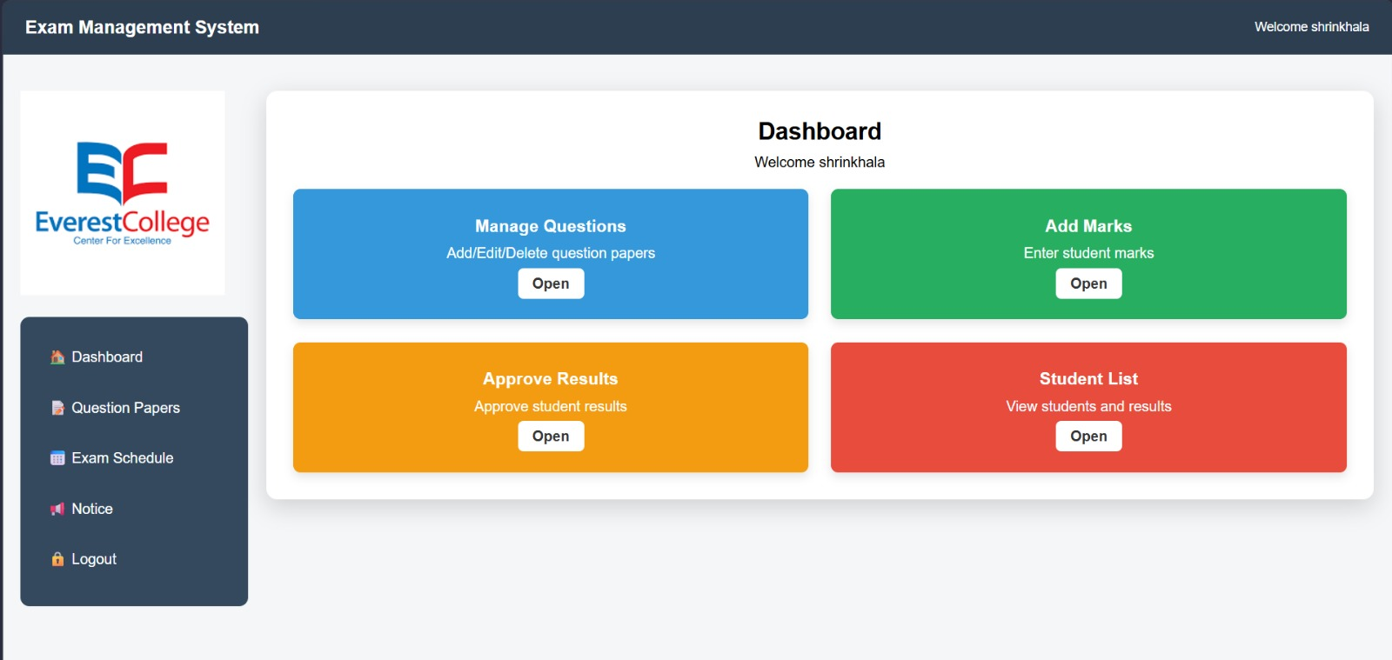
Teachers

Slide 22
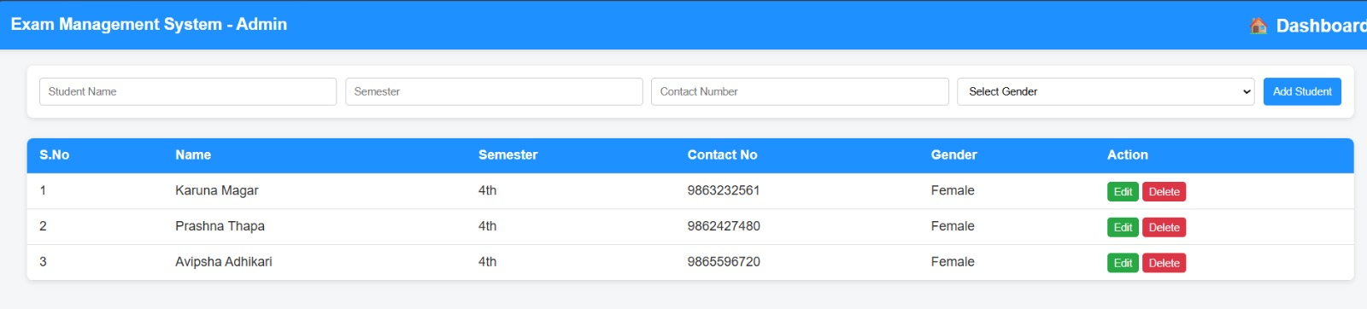
Role of Admin

Slide 23
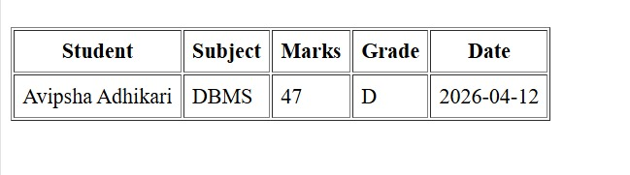
Results Managements

Slide 24
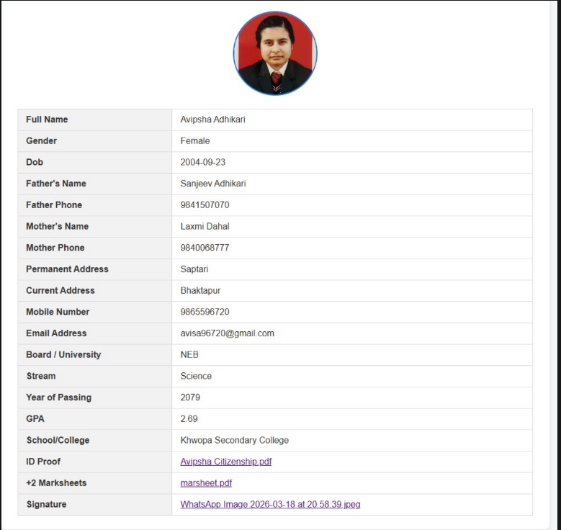
Students Profiles

Slide 25
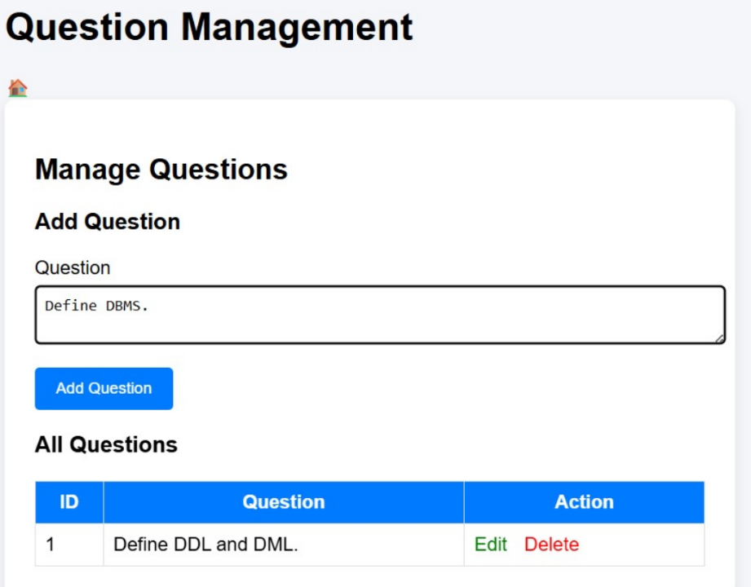
Question Management

Slide 26
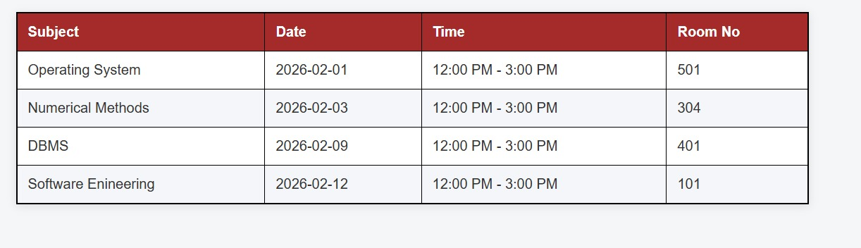
Exam Schedules

Slide 27
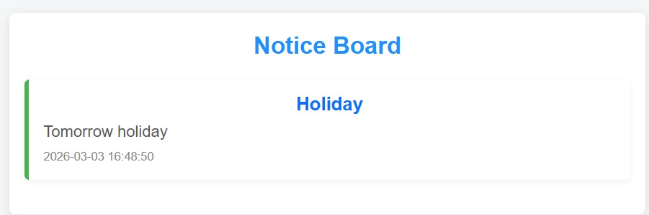
Notice

Slide 28
Conclusion
The Exam Management System is a simple and efficient system that helps manage examination activities like scheduling, marks entry, and result processing. It reduces manual work, minimizes errors, and improves accuracy and organization, making the exam process faster and more reliable.

Slide 29
ANY QUESTIONS ?

Slide 30
References
[1] R. S. Pressman, Software Engineering: A Practitioner’s Approach, 8th ed., McGraw-Hill, 2014.
[2] I. Sommerville, Software Engineering, 10th ed., Pearson, 2016.
[3] Uni Bytes, "BCA Project Documentation," 2024.
[4] SourceCodester, "Online Exam System Source Code," 2026.
[5] W. W. Royce, "Managing the Development of Large Software Systems," IEEE, 1970.
[6] E. Yourdon, Modern Structured Analysis, Prentice Hall, 1989.
[7] G. Booch et al., The Unified Modeling Language User Guide, Addison-Wesley, 2005.

Slide 31
Thank
You
Thank You!

